Slide 1
우주궤도역학 텀프로젝트
항공우주공학과
18011213 정준환

Slide 2
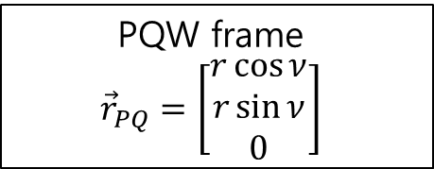
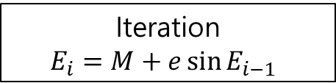
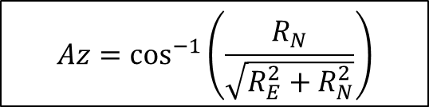
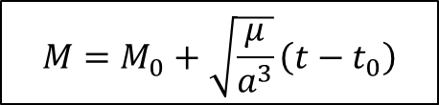


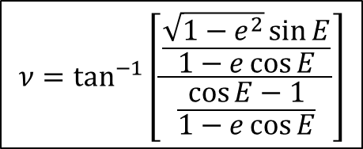
Used formula
$$M=M_{0}+\sqrt{\frac{μ}{a^{3}}}\left(t−t_{0}\right)$$
ECI frame
Iteration
$$E_{i}=M+e\sin{E_{i−1}}$$
ECEF frame
Geodetic frame
$$ν=\tan^{−1}\left[\frac{\frac{\sqrt{1−e^{2}}\sin{E}}{1−e\cos{E}}}{\frac{\cos{E}−1}{1−e\cos{E}}}\right]$$
ENU frame
$$El=\sin^{−1}\left(\frac{R_{u}}{R_{rel}}\right)$$
$$r=a(1−e\cos{E})$$
PQW frame
$${\vec{r}}_{PQ}=\left[\begin{matrix}r\cos{ν} \\ r\sin{ν} \\ 0\end{matrix}\right]$$
$$Az=\cos^{−1}\left(\frac{R_{N}}{\sqrt{R_{E}^{2}+R_{N}^{2}}}\right)$$

Slide 3
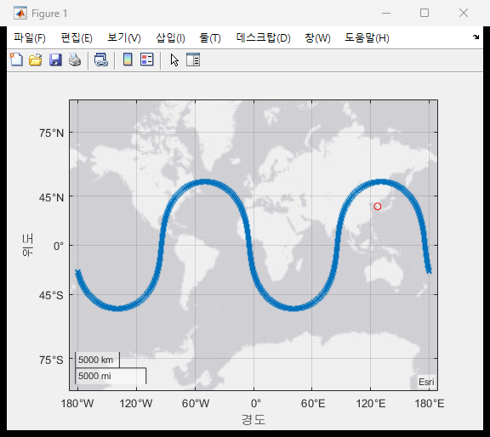
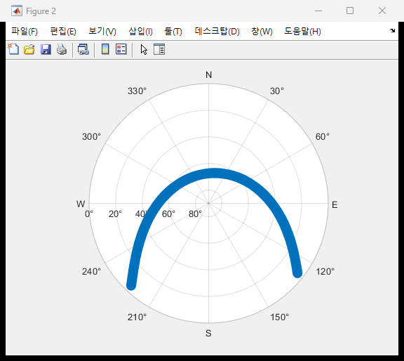
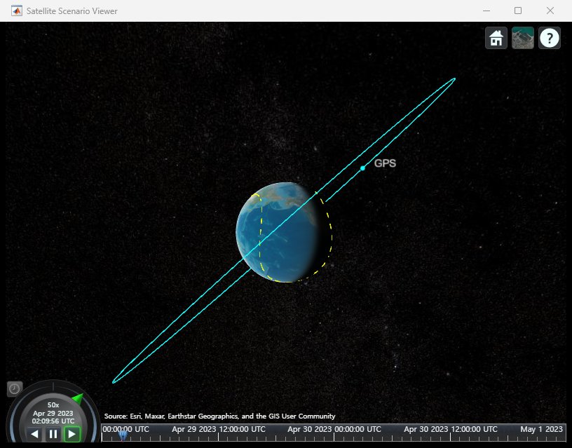
GPS result
Red circle in ground track is ground station
[Ground Track]
[Skyplot]
[Space view]

Slide 4
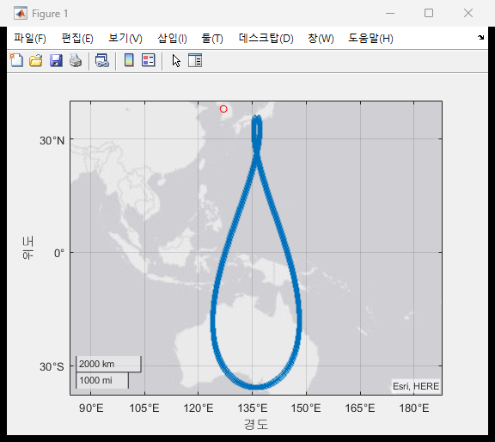
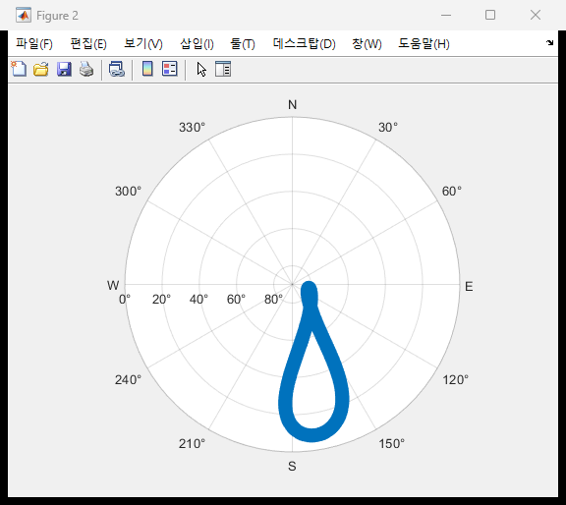
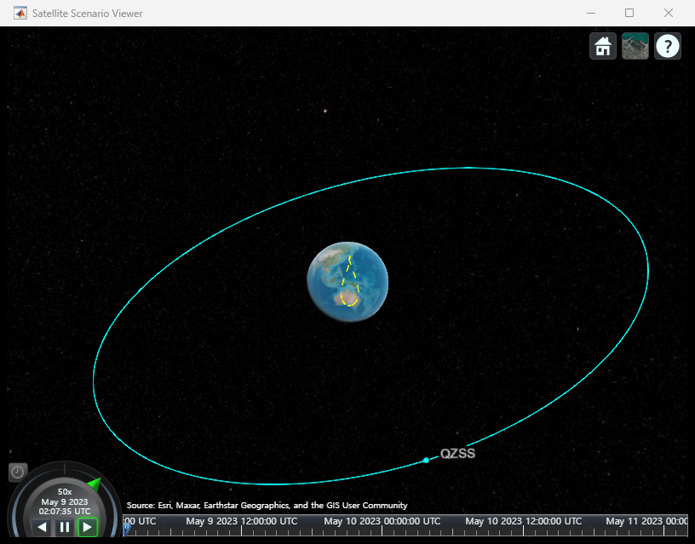
QZSS result
Red circle in ground track is ground station
[Ground Track]
[Skyplot]
[Space view]

Slide 5
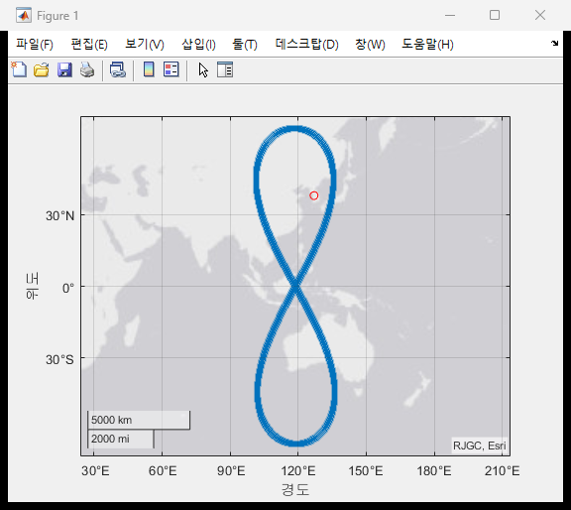
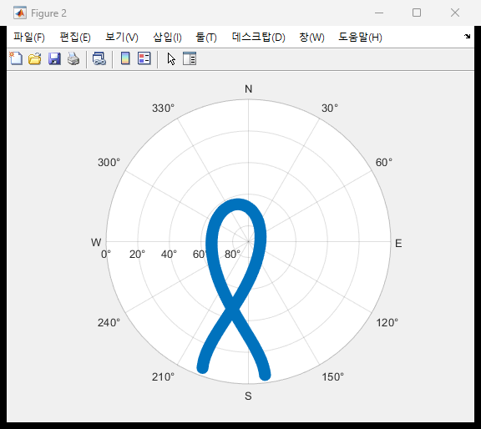
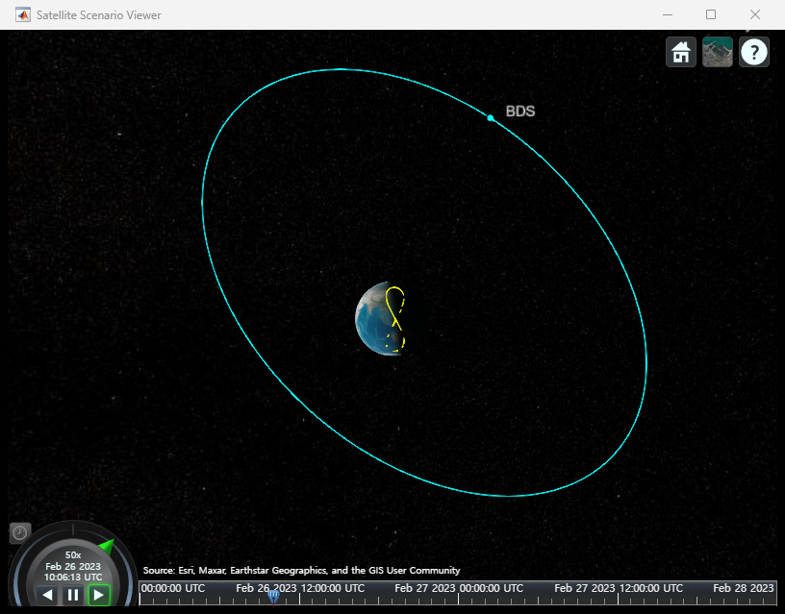
BDS result
Red circle in ground track is ground station
[Ground Track]
[Skyplot]
[Space view]

